Slide 1
8th Grade Homeroom

Slide 2
Homeroom Weekly Schedule
Monday – ELA iReady and PBIS conferences
Tuesday – Math iReady and PBIS conferences
Wednesday – Character Education
Thursday – Teambuilding and/or House Activity
Friday – 8th Grade Academy Activity
*Some weeks one or two days end up being changed to a school-wide activity that must be completed (like Digital Citizenship or PBIS activities).

Slide 3
The Importance of Attending Homeroom
Important information is passed out or delivered during homeroom.
Worthwhile activities and lessons are completed during homeroom.
Homeroom in 8th grade is how we determine our Academy Houses.
Houses are as follows:
Fidem: Braddock, Salvatore, Cambre, Carter
Tharros: Noto, Garrett, Erxleben, LeMieux
Amistad: Ruiz, McCaulley, Plantenys, Lee
Hekima: Davidson, Thomas, Brooks, Nelms

Slide 4
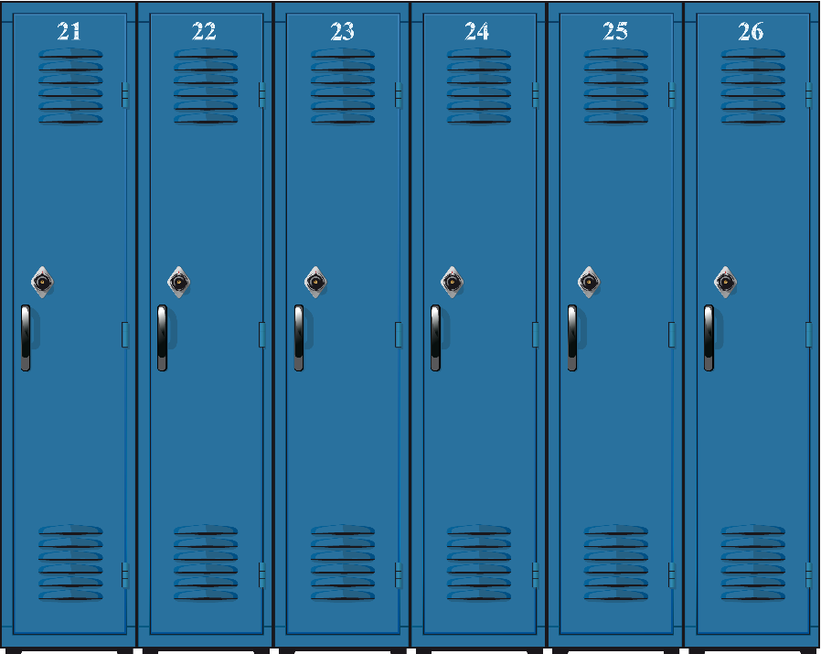
Locker Breaks
Students can determine when to go to their lockers, provided they arrive to class on time.
They do need to get their backpacks before 8th period, though.
They are NOT to go to their locker between lunch and homeroom.

Slide 5
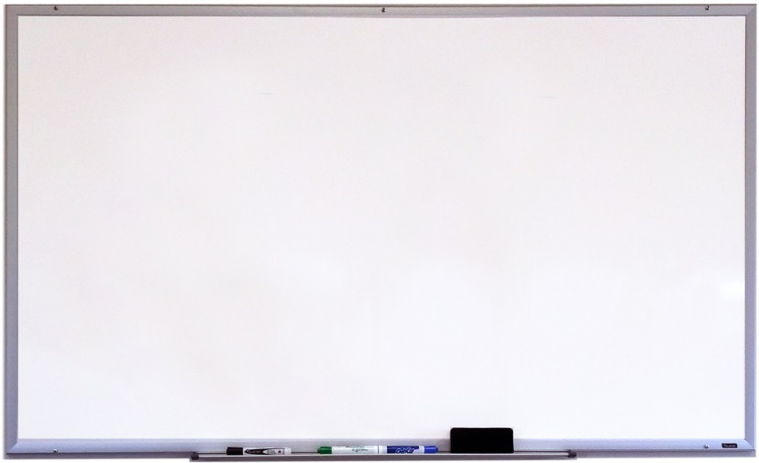
Front Office Whiteboard Policy
When you drop something off to the front office for student pickup, the student’s name is put on the whiteboard outside of the cafeteria.
Students should check that to know if something is in the office for them.

Slide 6
Student Arrival Policies
8th grade students should report to the gym if they arrive any time prior to 8:45. At no point should a student be in the halls or outside a teacher’s classroom door in anticipation of attending any help session.
Additional morning help sessions outside of these specified days listed below will require the teacher to issue a signed pass that must be presented to cafeteria/gym “holding time” monitors in order for any student to attend these sessions.
Morning Help Sessions Schedule: On these specified days, students may report directly to the appropriate classroom in order to attend an official help session for the below mentioned content-areas.
Monday: Social Studies
Tuesday: Language Arts
Wednesday: Reading and World Language
Thursday: Math
Friday: Science

Slide 7
Student Dismissal Policies
The front office announces which groups of students are dismissed in which order.
Students are to remain in their 8th period classroom until they are dismissed.
Most of the time:
Carpool, walkers, and back gate are dismissed first.
Then we usually have one load of buses.
Any changes in bus numbers or late buses are both announced and written down on classroom boards. Students are asked to listen carefully everyday because buses may change from day to day. On most occasions that a student misses the bus, the cause is not listening intently.

Slide 8
Student Dismissal Policies, cntd.
Only under circumstances of a need for child care can a student ride a different bus. Given that circumstance only, a parent must send a note to school with the student and include the following information: name of student, reason for bus change, bus number, destination address, destination phone number, parent signature, and parent contact phone number. This parent note must be submitted to the front office for approval or a student will not be allowed to alter their transportation.

Slide 9
Pre-planned Early Check-Outs
Write a note outlining the following –who (full name please) you are checking out, why you are checking out, date and time you are checking out, then sign and give a contact number. Please write legibly. Also, please note that the latest a student should check out is 3:30 pm. This avoids conflict with buses and car pool drivers arriving for dismissal.
Your student should bring this note to the front office on the day of the pre-planned early dismissal. The note will be approved and will then serve as a pass out of class at the noted time. Your student is then instructed to report to the front office at your stated time so be sure this accurately represents when you want them to be at the front office.
Check out (and in) requires that you enter the school front office and your student exit or enter with you.
When you arrive, you will sign your student out in the log and they will have reported to the front office as instructed.

