Slide 1
CURRICULUM NIGHT September 6, 2018
Mrs. Erxleben
Algebra 1
Accelerated Algebra 1/Geometry A

Slide 2
Teacher Introduction

Slide 3
Positive Behavior Interventions & Supports
(PBIS)
The 3 Bs: Be Prepared, Be Engaged, & Be Respectful
Students can earn up to 5 points in each class period for meeting the “3 Bs” expectations. Students can use their points throughout the school year to participate in rewards and purchase items for the PBIS School Store.
-Be Prepared- on time (1 point)
-Be Prepared- have materials (1 point)
-Be Engaged- on task (1 point)
-Be Engaged-appropriate technology use (1 point)
-Be Respectful- on task (1 point)
Students can check their points at www.student.pbisrewards.com
Parents can check students’ points using the PBIS Rewards app (Apple and Android)
One-on-one conferences with Homeroom Teachers weekly/biweekly

Slide 4
Daily Agenda
Warmup – review of material taught in a previous lesson
Homework Questions – students make appropriate corrections
New material (Georgia Standards of Excellence (GSE)) – direct instruction, independent/partner practice, collaborative activities, use of manipulatives & technology
Summary – students paraphrase process/steps, checks for understanding

Slide 5
Homework
Extensions of the learning process
Posted on teacher web site
Assigned daily with few exceptions
Checked for completion & effort
Struggles may occur – discussions take place the following day while we review the homework to ensure clarification

Slide 6
8th Grade Acc Alg/Geom GSE 9 Units of Study
Relationships Between Quantities and Expressions
Reasoning with Linear Equations and Inequalities
Modeling and Analyzing Quadratic Functions
Modeling and Analyzing Exponential Functions
Comparing and Contrasting Functions
Describing Data
Transformations in the Coordinate Plane
Similarity, Congruence, and Proofs
Right Triangle Trigonometry

Slide 7
GRADING SCALE
Test 45%
Quizzes 20%
Homework 15%
Final Exam 20%

Slide 8
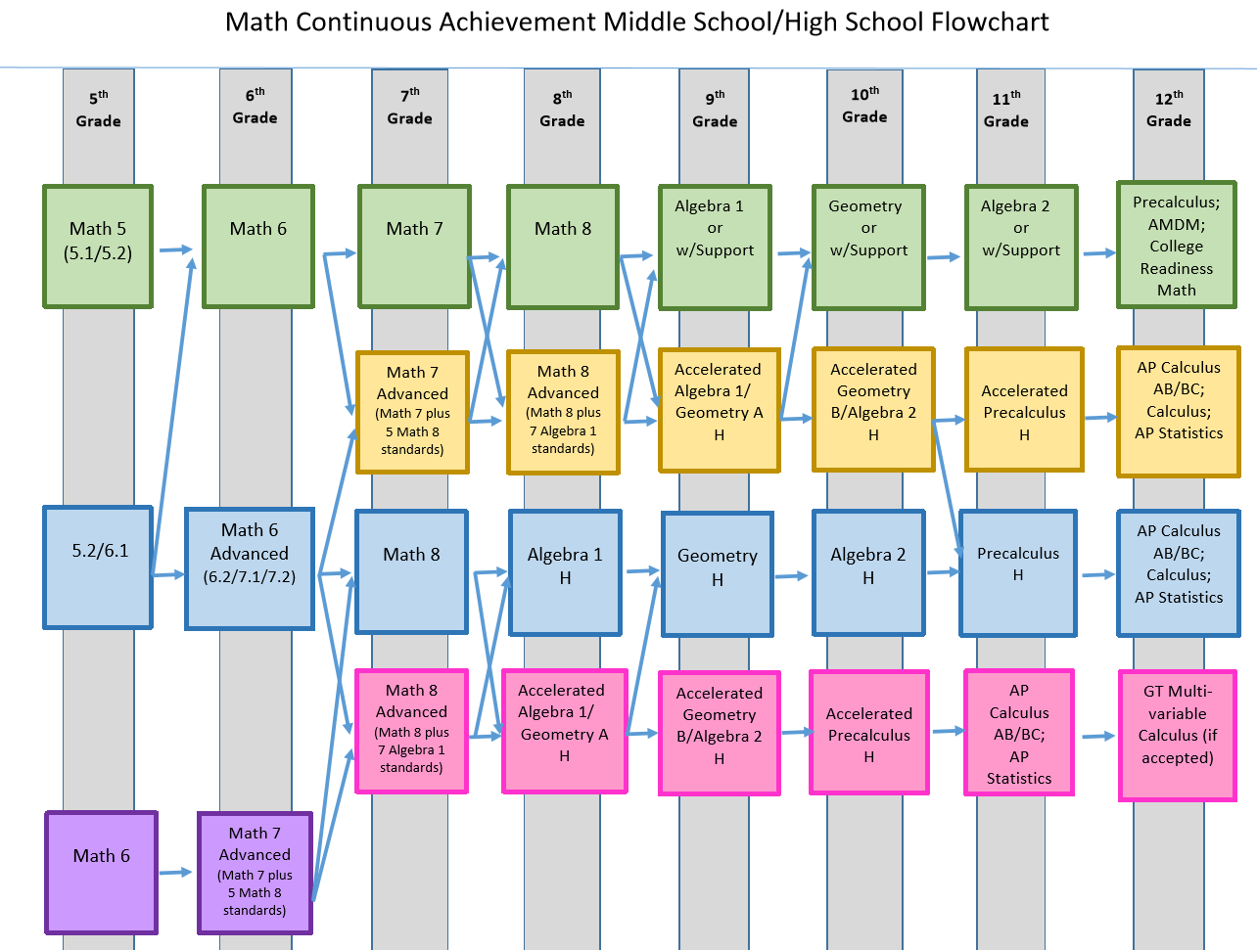

Slide 9
OTHER NOTES
Help sessions: Thursdays at 8:00AM (or most mornings)
Teacher web site: mathisfunwitherxleben.weebly.com
Email: erxlebenm@fultonschools.org

Slide 10
QUESTIONS?

