Slide 1
Unit 2 Test Review
Please have out scratch paper, a pencil and your device showing Desmos.com

Slide 2

Algebraic Proofs
Write a two column proof.
Given: $3\left(−2x+4\right)+x=12x−5$
Prove: $x=1$

Slide 3
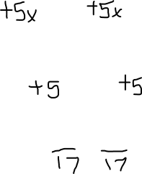
$$3\left(−2x+4\right)+x=12x−5$$
Given
Distributive Property
Substitution Property
Addition Property of Equality
Substitution Property
Addition Property of Equality
Substitution Property
Division Property of Equality
Substitution Property
Symmetric Property
$$−6x+12+x=12x−5$$
$$−5x+12=12x−5$$
$$12=17x−5$$
$$17=17x$$
$$1=x$$
$$x=1$$

Slide 4

Given two points, write the linear equation in all 3 forms
$$\left(−3, 2\right)and (0,6)$$

Slide 5
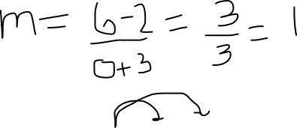

Slide 6
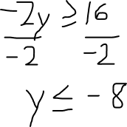
Solve and graph the inequality
$$y≥3y+16$$

Slide 7
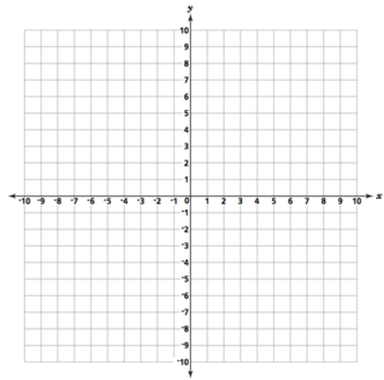
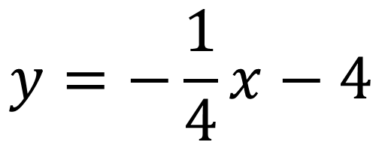
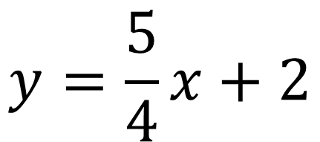
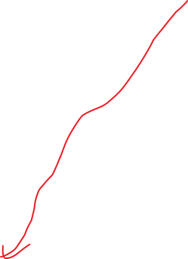
Solve the system of equations by graphing
$$y=−\frac{1}{4}x−4$$
$$y=\frac{5}{4}x+2$$

Slide 8
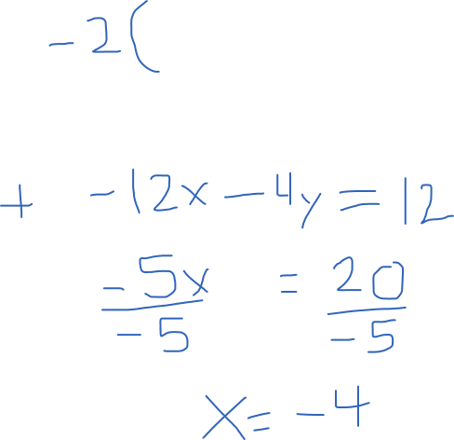
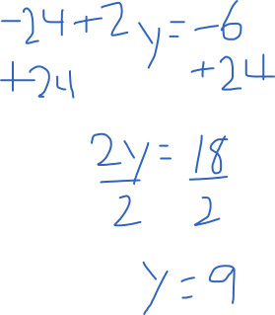

Solve the system of equations by elimination
$$6x+2y=−6$$
$$7x+4y= 8$$

Slide 9
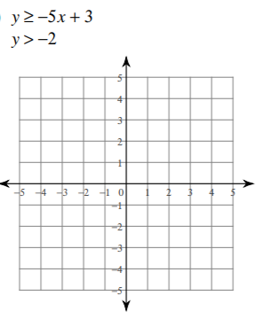
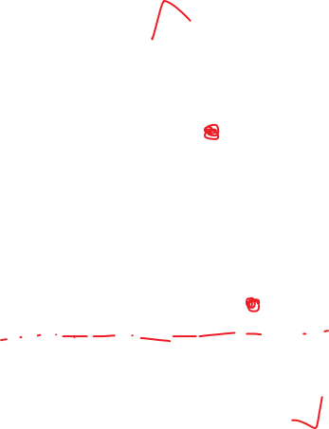
Solve and graph the system of inequalities

Slide 10
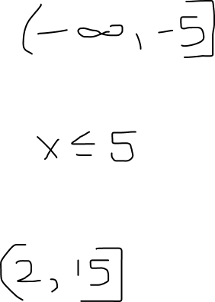
Interval Notation Practice
Put in interval notation and graph the inequality.
$$y≤−5$$
Write each interval as an inequality.
$(−∞,$10]
Write the interval notation that describes the graph.

Slide 11
Word Problems
Some coins (dimes and nickels) are in a pile. The total value of the pile is $1.35. The number of nickels is one coin less than twice the number of dimes. Using a system of equations, find the number of each type of coin.

Slide 12
